Slide 1


Illinois Department of Public Health Twitter Analysis
Presented by: -
Nupur, Neil, Anuj, Shweta,
Sanjana, Adithi, Kalyani, Devansh

Slide 2
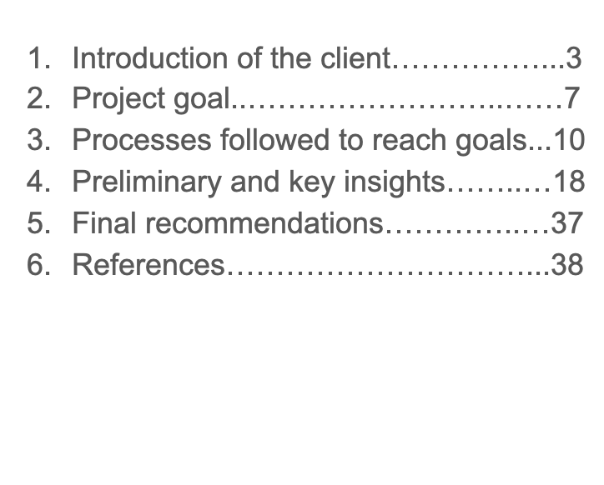
Contents

Slide 3

Introduction of the client
Client: All Local Health Departments under Illinois Department of Public Health.
About IDPH -
The Illinois Department of Public Health (IDPH) is an agency that prevents and controls disease and injury, regulates medical practitioners, and promotes sanitation
It is headquartered in Springfield and has administrative offices in seven regional locations
IDPH has 200 different programs that benefit each resident and visitor of Illinois State
The regional offices coordinate various program activities at the local level, including organizing surveys and inspection activities for public and local health agencies
IDPH Vision
Communities of Illinois will achieve and maintain optimal health and safety

Slide 4
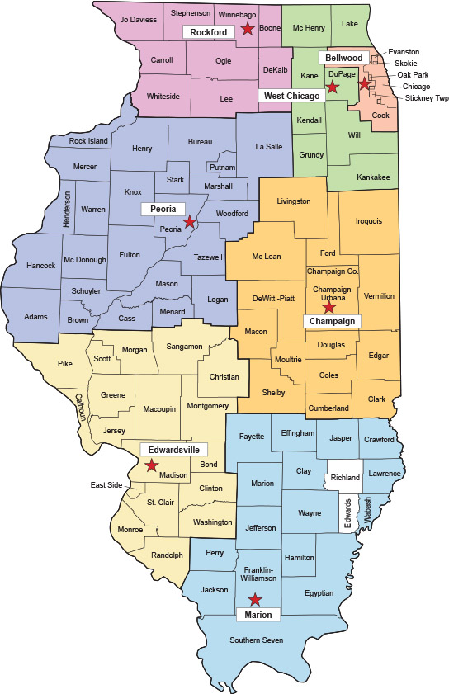
Introduction of the client
About Local Health Department (LHD) -
An LHD is an agency of local government that develops and administers programs and services that are aimed at maintaining a healthy community
There are 97 local health departments, covering 100 of the state's 102 counties, serve 99.5 percent of the population in Illinois State

Slide 5
Services provided by an LHD:
Enforce the health directives from the government
Develop their own policies and plans that support the health efforts
Track, investigate and prevent diseases and public health threats
Inform the public about health problems in the community and how to stay safe
Use social media to improve their outreach for imparting information

Slide 6
How Twitter helps in public engagement for any business
Engagement: @Replies Retweets Mentions Favorites Hashtags
Public engagement statistics show that the below characteristics are significant for user involvement for tweets:
Mentions
Retweets
Favorites
Hash
Tags

Slide 7
Project Goal:
Analyze the nature of tweets being posted by LHD twitter handles
Analyze the current involvement pattern of twitter users with respect to these LHD tweets
Analyze twitter data to give insights on the LHDs Twitter usage and provide recommendations to improve the same.
Analyze the factors affecting the popularity (favorites/retweets) of the tweets

Slide 8
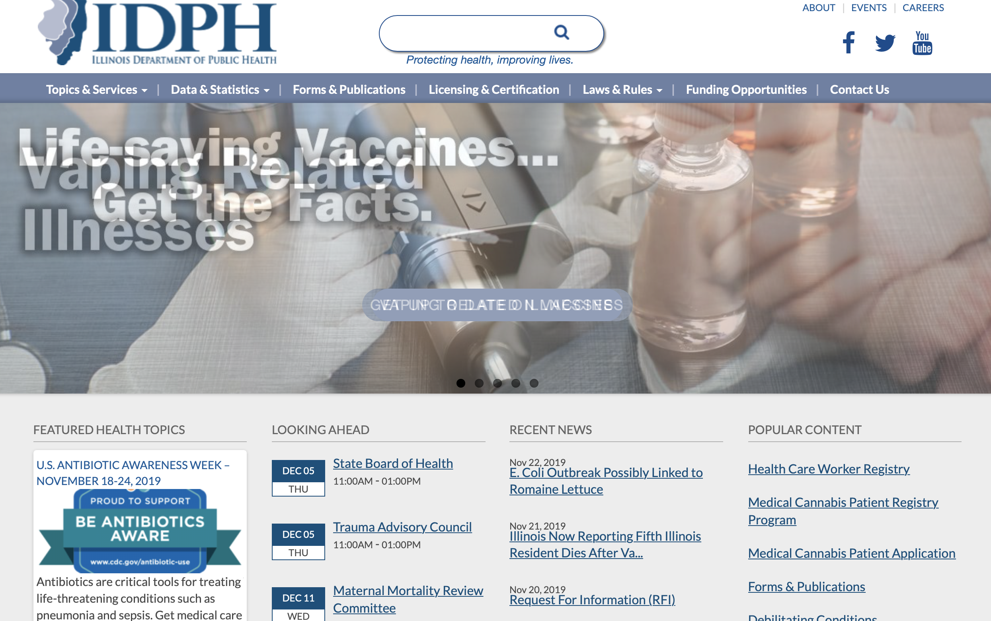
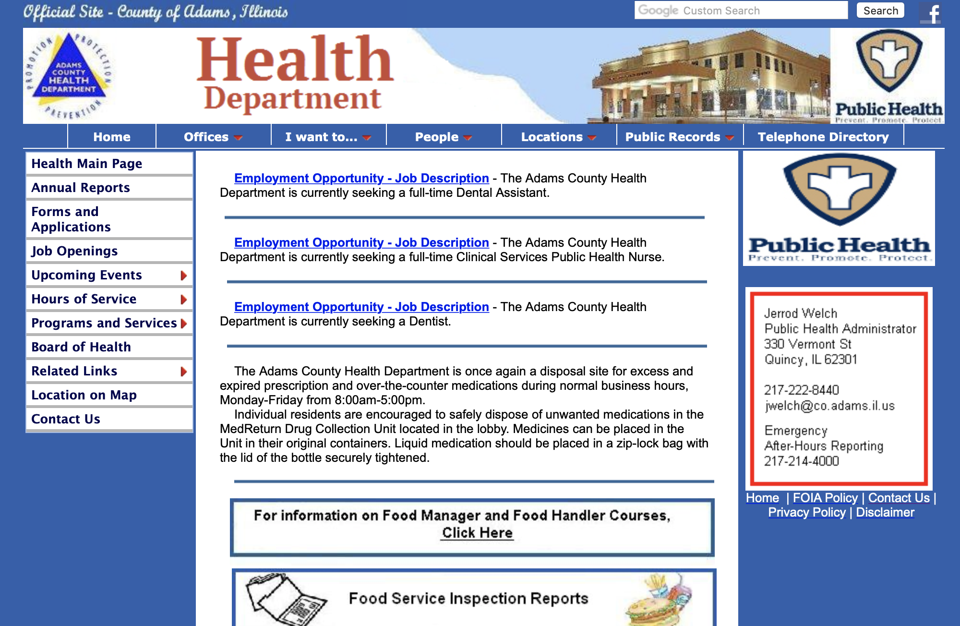
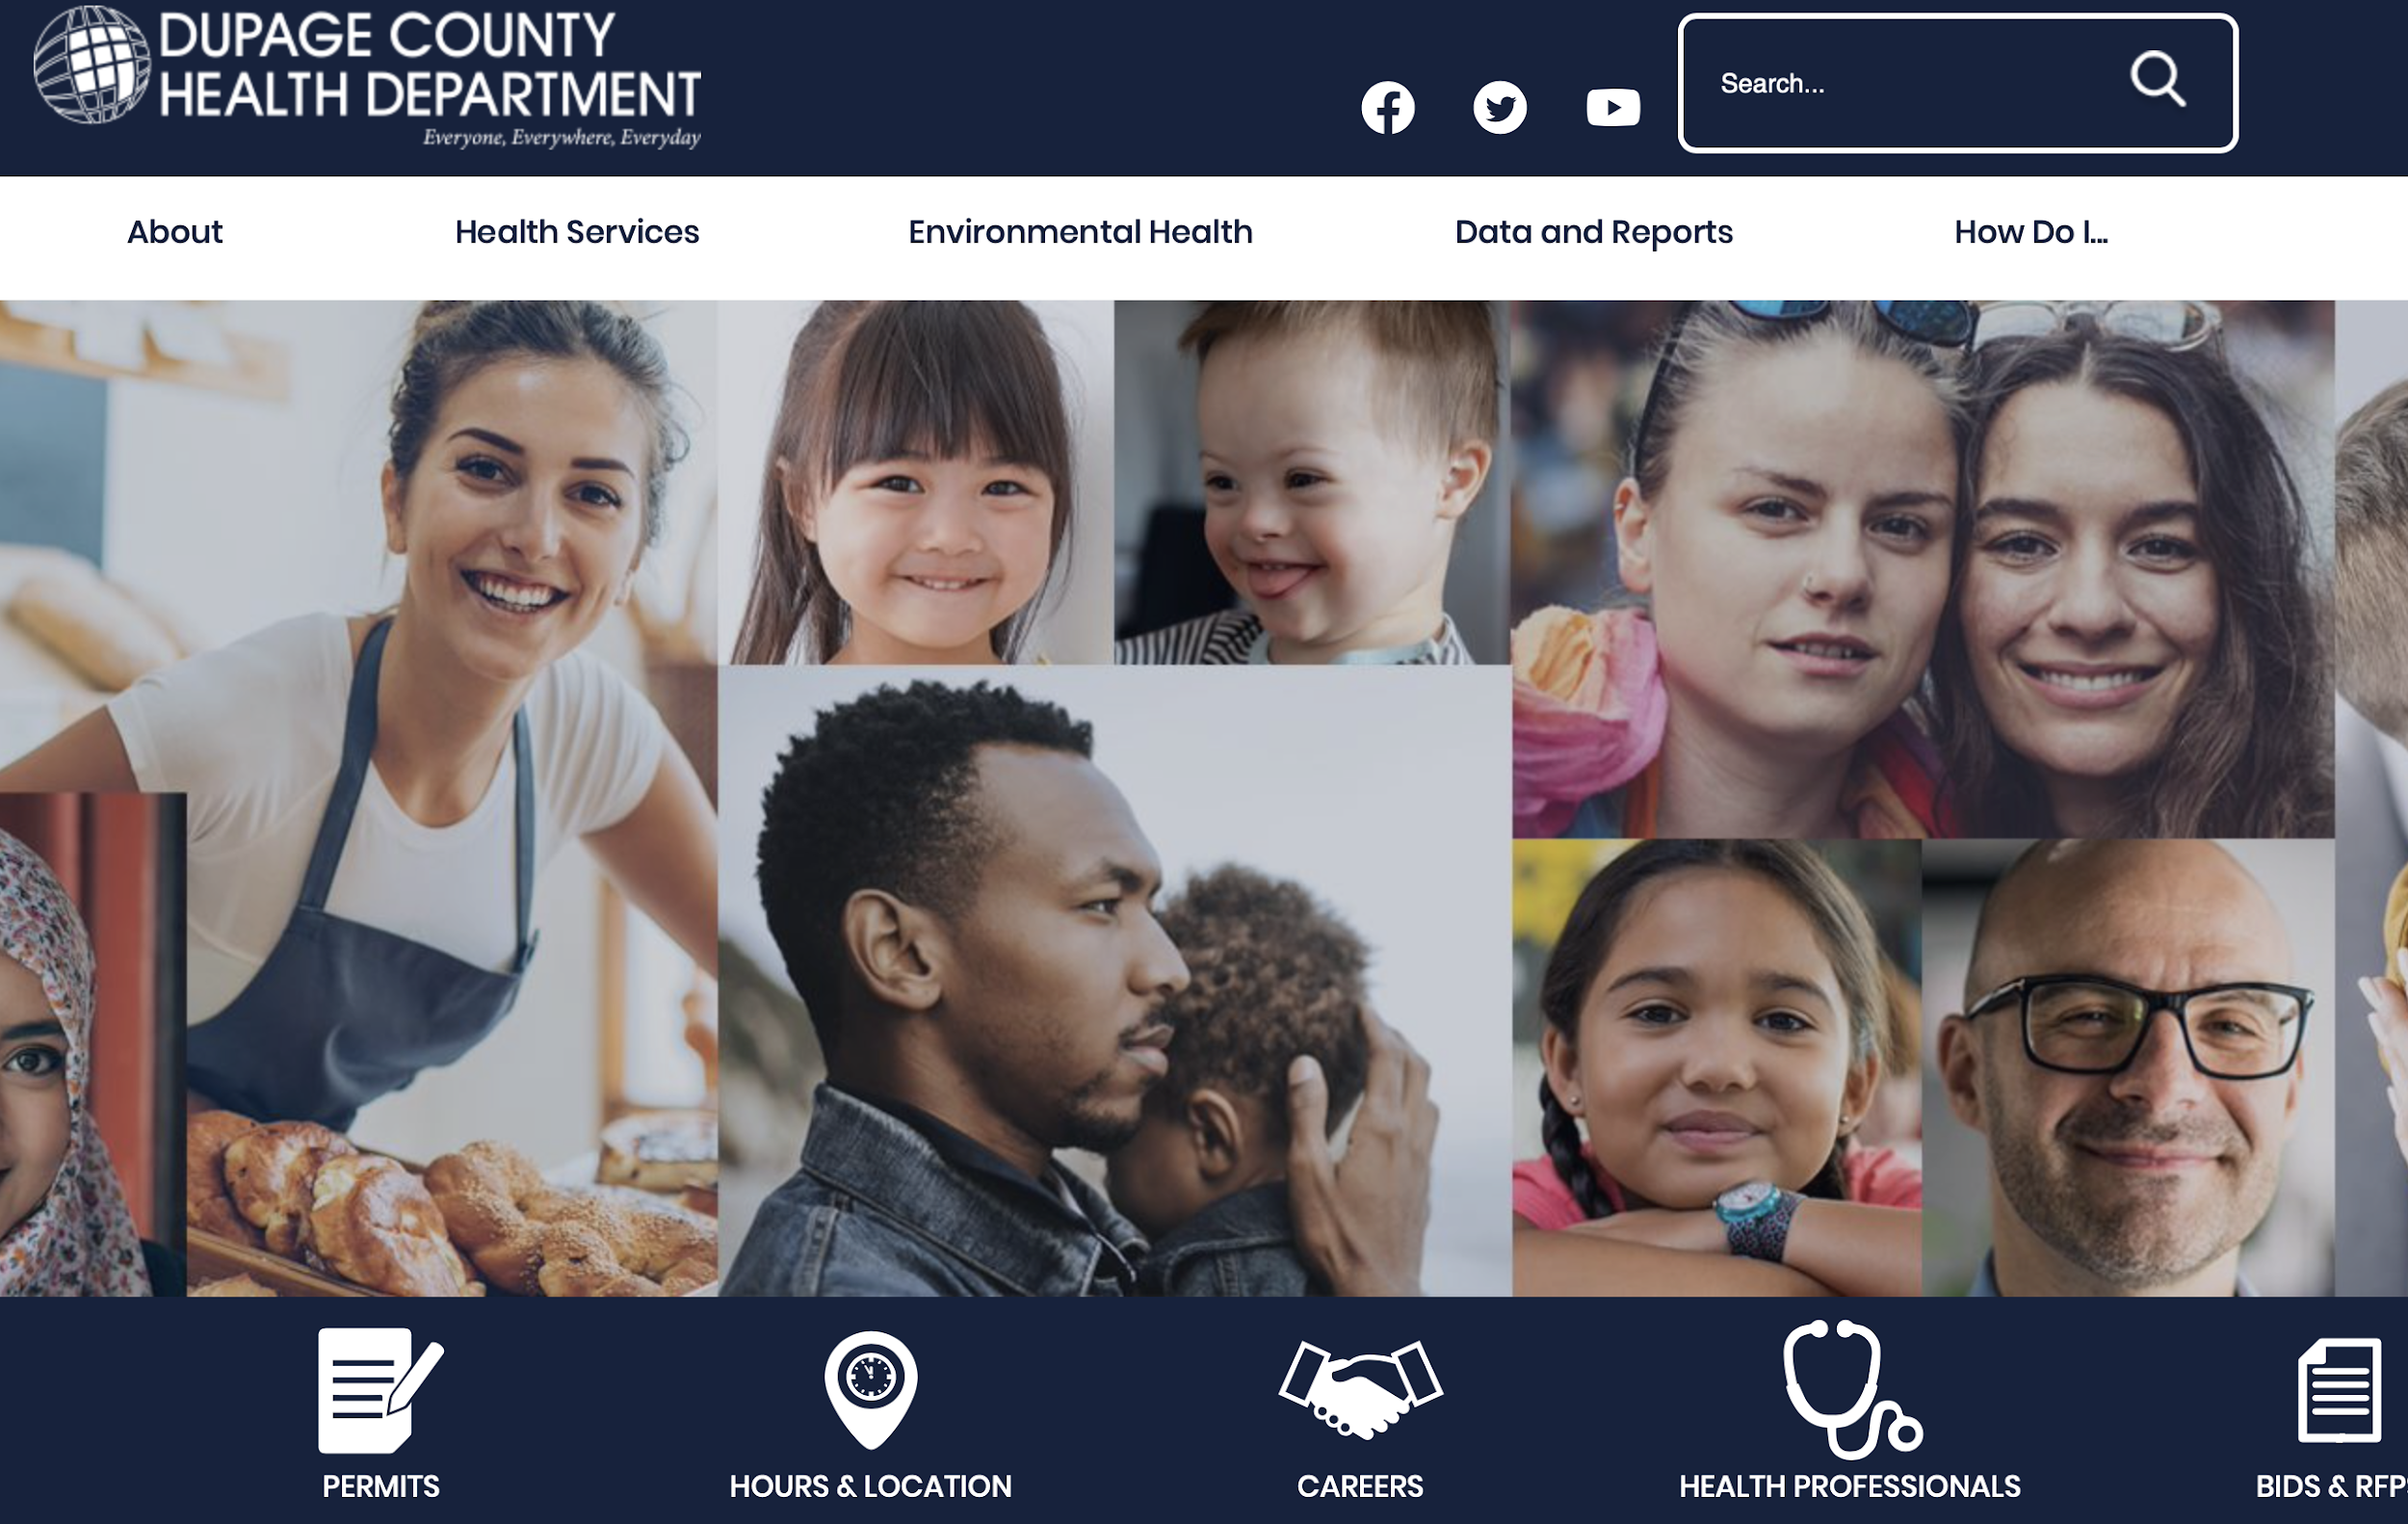
Current status of the LHD’s website and social media presence
Some LHDs were using the Illinois Department of Public Health (IDPH) as their parent site and were not maintaining their own websites
It was observed the Local Health Departments may or may not have Facebook, Instagram, or Twitter presence
Illinois Department of Public Health website
Adams county website with no twitter handle
(http://www.co.adams.il.us/health/index.htm)
DuPage county website with twitter handle
(https://www.dupagehealth.org)

Slide 9
Data agglomeration methods analysis
There are several ways to aggregate data:
Collect new data: Use tools (software) to retrieve and store new data
Transform legacy data: If the data is present but is not proper
Purchase data: When the data in question is confidential
In this project, the data is public but it is not centrally stored anywhere, except in the social network website itself
It is also not in a format that is ready for analysis. Thus, this requires:
Extraction of data from twitter using Python
Stored all the raw data into excel or csv files for further analysis

Slide 10
Process followed to reach goals
Selecting LHDs on twitter presence
Recording other social media presence (if any)
Tweet data extraction
Labelling and classification of data
Provide recommendations
Selecting the LHD
Other Social Media
Tweet data
Classification of Tweets
Recommendation to LHD
97 LHDs had online websites
Out of which 41 LHDs had twitter presence
Out of which 30 LHDs had total number of tweets >60
Recorded Facebook and Instagram presence
30 LHDs on Facebook, 2 LHDs on Instagram
• Extracted 53705 tweets from twitter using Python API
• 38911 tweets were analyzed after removing retweets
Classify the tweets into 7 mutually exclusive categories based on their characteristics
Extract the content to drive meaningful results
Perform statistical analysis and data mining on clean and processed data
Provide recommendation to the client to improve the twitter usage by the health departments
Notes:
Notes: 1)how we arrived on 97->41->31.
Make a flow chart on it.
Record fb or insta presence
Tweet extraction
Labelling based on the classification
Modeling and
Regression

Slide 11
DATA EXTRACTION
Creation of Twitter Developer Account
Extraction of tweets using Python API
(53705 tweets with a maximum of 3000 most recent tweets per county)
Data extracted contained 90 tweet attributes (retweets, favorites, hashtags, etc) in JSON format
Removed the Retweets from the extracted data (~13,000 retweets were removed, final set had 38911 tweets)

Slide 12
CLASSIFICATION OF TWEETS USING AUTOML
MANUAL CLASSIFICATION:
Buckets created to segregate tweets into categories
Classification of subset of tweets based on bucket guidelines
TRAINING AUTOML MODEL
Creation of Google Auto ML account
Trained the Model using 1600 tweets based on above manual classification of 800 tweets
Performed batch processing of 38911 tweets to classify larger number of tweets on basis of the trained model and reclassified the incorrect ones to improve the accuracy in iterative approach
Classified the tweets into respective buckets with 96% precision and validated the same

Slide 13
Categories for analyzing tweets from an LHD
Events
Rule: Tweets with date and time that identify an occasion
Examples
"Come learn about changing the perception and discussion of mental illness on May 10th, 5:00pm at the Dixon Elks Lodge"
"DeKalb County is hosting a blood drive TODAY from 12:00-4:00PM (last time slots 3:40PM)! Please feel free to walk-in to our Multipurpose Room located at 2574 North Annie Glidden Road in DeKalb. https://t.co/D06qUUvp08"
Administrative and services
Rule: Operational information from LHD (Promoting the LHD, Hospital, Infrastructure info.)
Examples
"The Whiteside County Community Lab is a simple way to save money on your lab work, call us at 815-626-2230 and find out how we can help today! https://t.co/iyhkY7SjOB"
"Call 815-626-2230 and ask how we can help you today! We are offering Free HIV testing the month of December please call us at 815-626-2230 and schedule yours today. #KnowYourStatus"

Slide 14
Health Literacy
Rule: Health awareness and informational tweets for disease prevention and improvement of health
Examples
"Hypothermia can set in if your body temperature drops just 2 degrees so protect yourself from wind chill by dressing warmly and limiting activities outside. Visit https://t.co/3EWTnATpkN for more tips on staying warm this season. https://t.co/HONe9XMFh7"
"It’s Men’s Health Month, and there are a lot of ways to get healthier this year. Check out some of the biggest health problems men face. #MensHealthMonth"
Food and Drug Literacy
Rule: Occurrence of Consumable food items or drugs
Examples
"Eating healthy can be hard, but there are easy ways to incorporate more fruits and veggies into your meals"
"Daily Health Fact: It is estimated that 23% of individuals who use heroin develop an opioid addiction"

Slide 15
Childcare Literacy
Rule: Childcare or infant health awareness or information for parents
Examples
"#Vaccines help protect babies against 14 diseases by age 2. Help parents know which shots their baby needs: "
"DYK #Breastfeeding reduces your baby's risk of respiratory infection, diabetes, obesity and SIDS?"
General
Rule: Tweets with holiday wishes or environmental awareness
Examples
"How can climate impact your health? https://t.co/OfgGbcIS2D"
"Happy #ForthOfJuly from your friends at the Whiteside County Community Health Center!"
Alert and News
Rule: Occurrence of serious health threat, time sensitive alerts or news that needs attention
Examples
"First West Nile virus mosquitoes in Peoria"
"https://t.co/k7vUNmf2PB https://t.co/0XWxpZcJXG#FlashFloodWarning for Galesburg, Wataga, Oneida, Altona, Victoria, Rio, East Galesburg, Henderson, Snake Den Hollow and I-74 between mile markers 34 and 47 until 6:15 PM. #TurnAroundDontDrown when encountering flooded roads. Most flood deaths occur in vehicles."

Slide 16
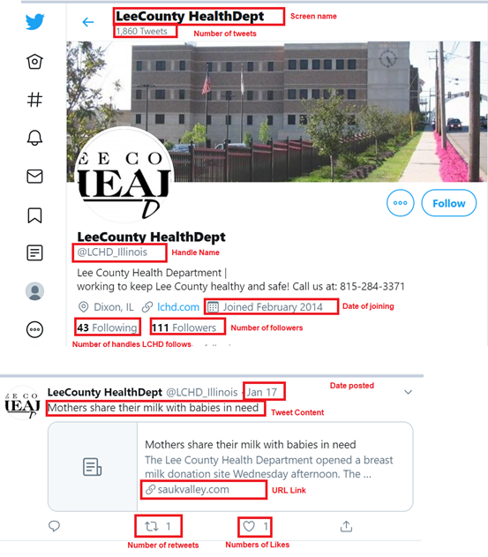
Variable characteristics
Type | Variable list | Definition
LHD characteristics | Population (number) | Population of the county
Twitter handle characteristics | Followers (number) Following (number) Total tweets (number) | Number of twitter accounts that follow the LHD Number of twitter accounts followed by LHD Number of tweets posted by a handle - Upto 3000 (Most recent)
Tweet characteristics | Retweets (number) Favorites (number) Hashtags count (number) User Mentions (number) Source (34 categories) Is media (4 categories) Bucket (7 categories) Created_at (timestamp) | When a user directly shares a Twitter accounts brand message with their audience When a user stars a Tweet as an appreciation When a user uses hashtag(#) symbol Mention of @ symbol to include other user handles in tweet Source from which a tweet originated E.g: Facebook, Hootsuite, Twitter for iPhone, etc Indicates the presence of media in the tweet Category based on tweet content (E.g: Health Literacy, Alert and News, General, etc) Time and Date when the tweet was posted

Slide 17
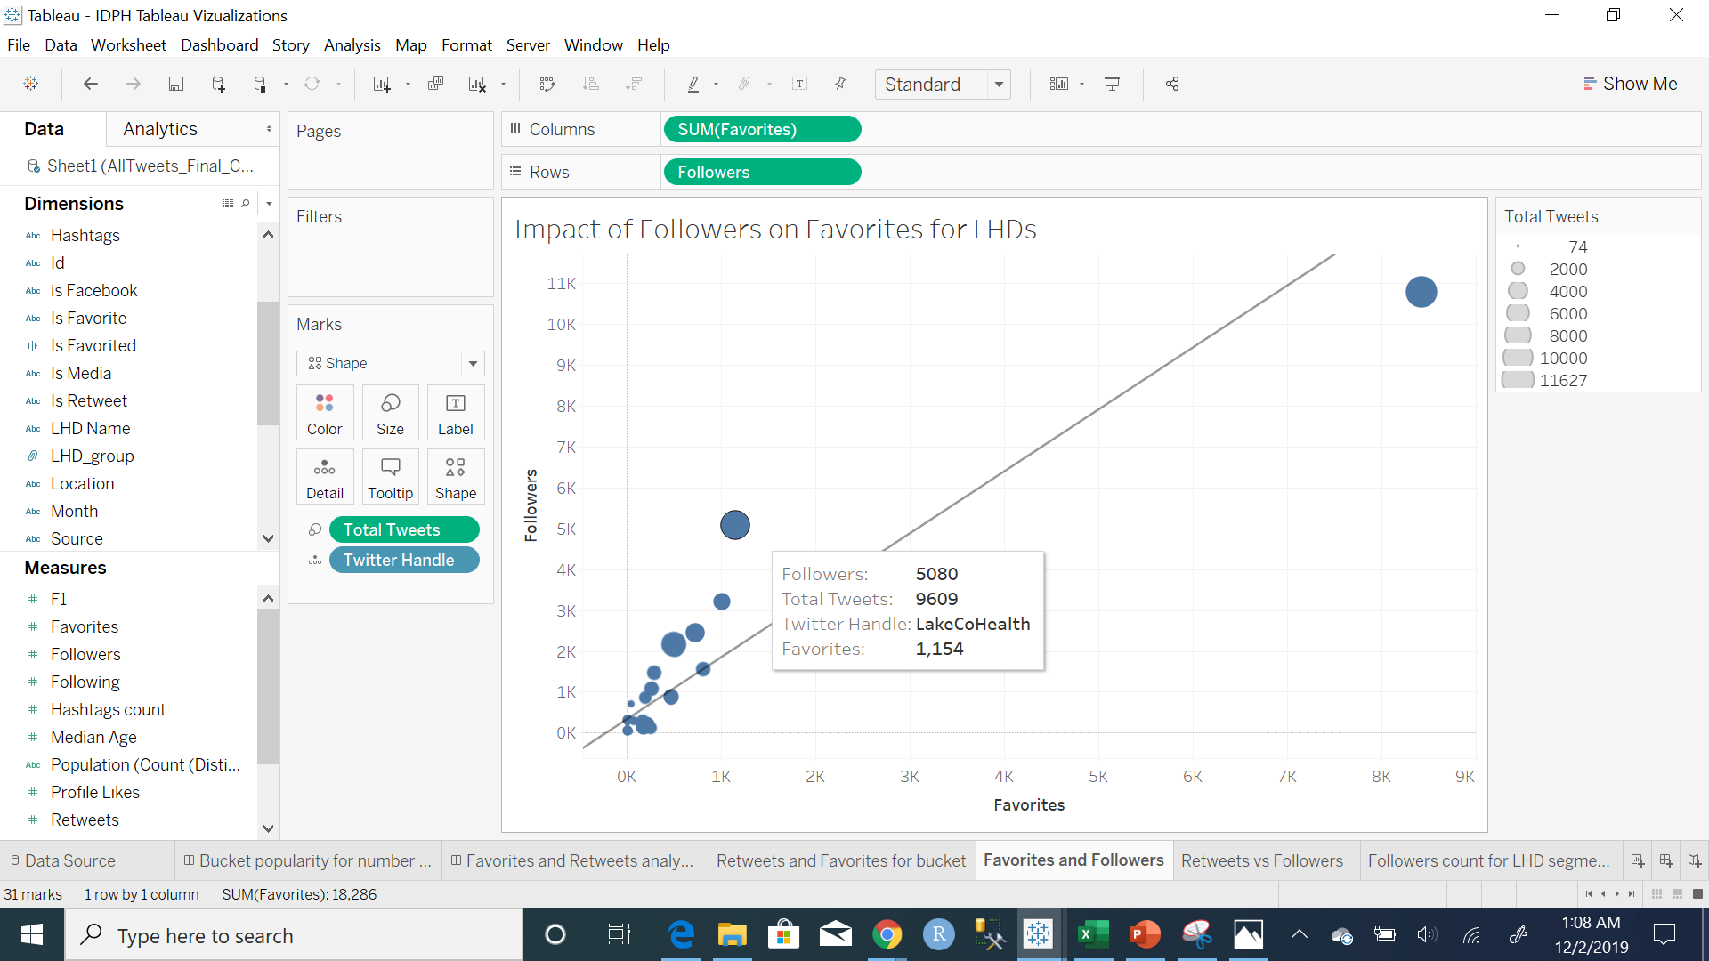
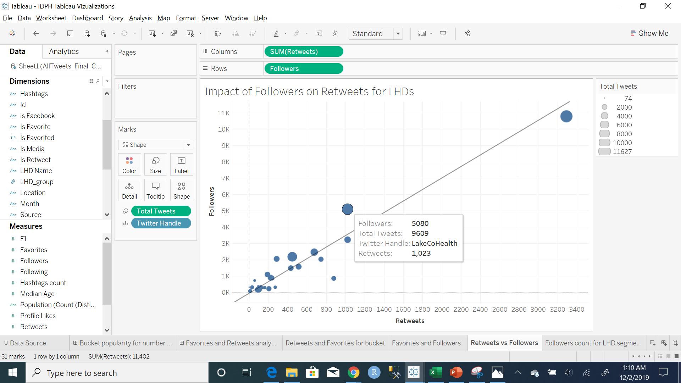
Preliminary Insights
The number of followers for each twitter handle varied considerably
Higher the number of followers for a twitter handle, greater the amount of retweets received by the tweets posted by that handle
Similarly, higher the number of followers for a handle, greater the number of favorites were received by the tweets posted by that handle

Slide 18
Model Overview
LHD CHARACTERISTICS
MODELING
Retweets
Favorites
TWITTER HANDLE CHARACTERISTICS
MODEL RESULTS
TWEET CHARACTERISTICS

Slide 19
LHD segmentation based on followers
Since the number of followers had an impact on the number of retweets, the twitter handles were segmented into 3 types:
Large (75th Percentile to Maximum)
Medium (25th Percentile to 75th Percentile)
Small (Minimum to 25th Percentile)
Based on this result we could categorize 6 LHDs as Large, 11 LHDs as Medium and 13 LHDs as Small

Slide 20
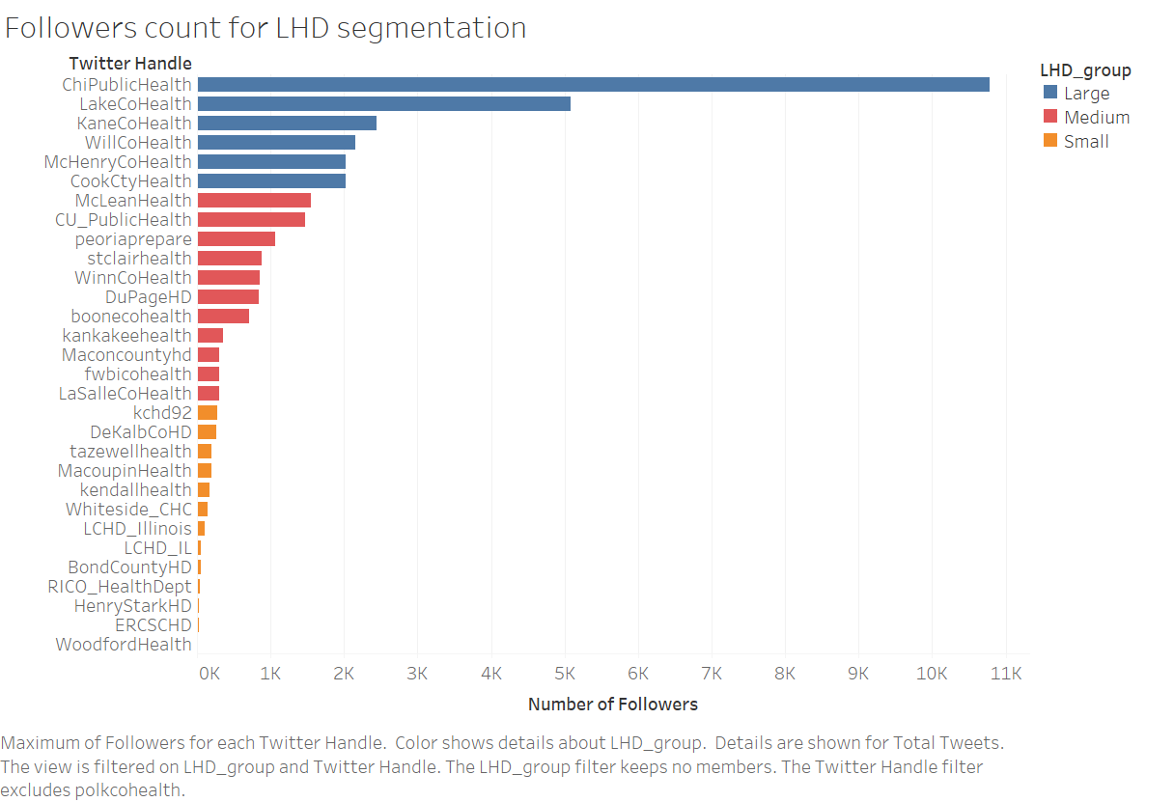
LHD segmentation based on followers

Slide 21
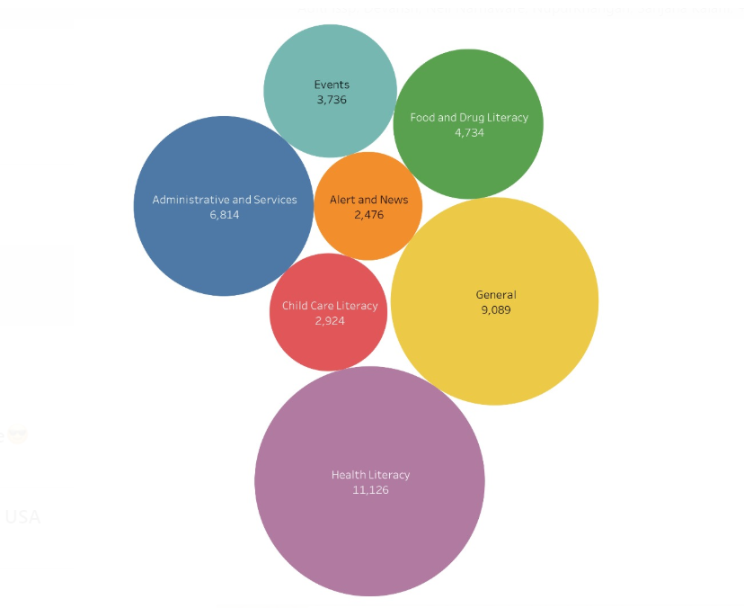
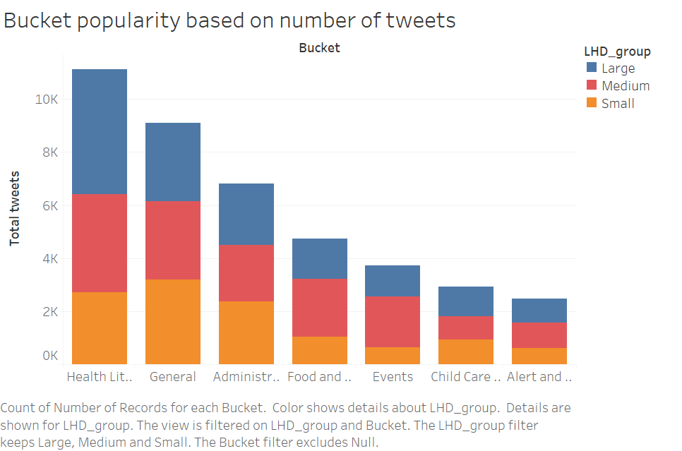
Bucket Popularity based on Number of Tweets

Slide 22
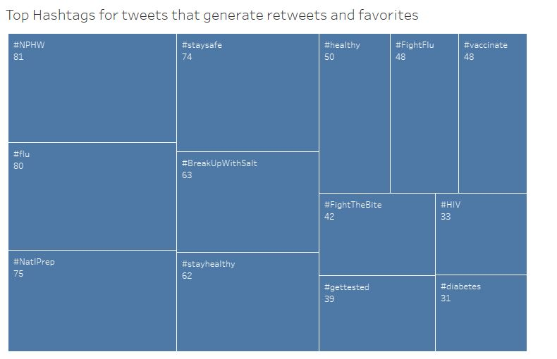

Slide 23

Recommendations to get Favorites
Small LHDs
Favorites – Min: 0, Max: 10
Medium LHDs
Favorites - Min: 0, Max: 46
Large LHDs
Favorites – Min: 0, Max: 3933
Only 9% of tweets had at least 1 favourite
Handles of Top tweets had most followers and those tweets had pictures
If there is at least 1 user mentioned in the tweet, the odds of getting at least one favorite are doubled
Buckets: Administrative & Services, General
15% of tweets had at least 1 favourite
Handles of top tweets had maximum posts and they had some of the popular hashtags
If there are two hashtags in the tweet, the odds of getting a favorite increase by 91%
The usage of Hootsuite increases the likelihood of getting a favorite by 60%
Buckets: General, Events, Child Care Literacy
31.6% of tweets had at least 1 favourite
Mentioning a user increases the odds of getting a favourite by 27% and if the tweet belongs to Health Literacy bucket, the odds reduce by 25%
Mentioning a popular user in the tweet is very important to grab attention of users as these LHDs cover a large population
Use of media increases the odds by 2.5 times
Months: Feb, May, and Dec

Slide 24
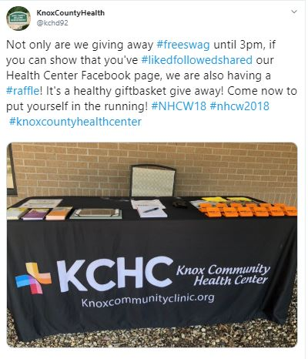
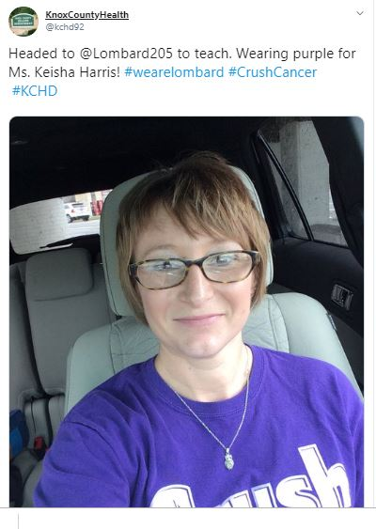

Small LHDs Favorites
Notes:
Administrative and services, Adm and services, Events

Slide 25
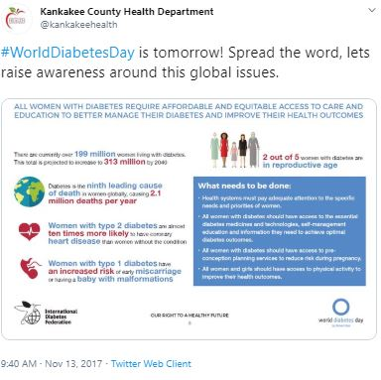
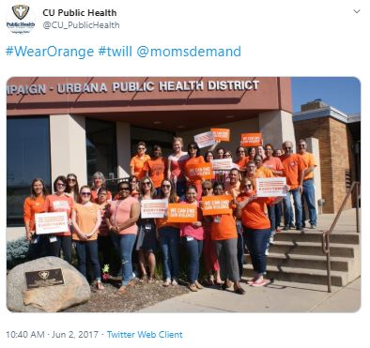
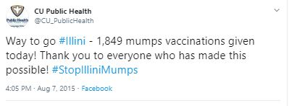
Medium LHDs Favorites
Notes:
Health Literacy, General and Child care literacy

Slide 26
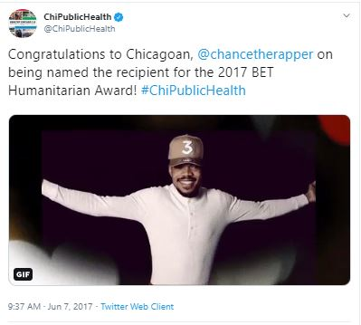

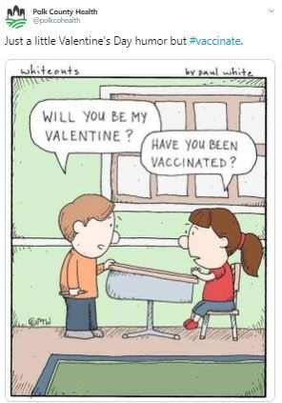
Large LHDs Favorites
Notes:
Power user mention, Strong hashtags, Images in all three
Buckets don’t matter

Slide 27

Insights on How to get Retweets?
Small LHDs
Retweets – Min: 0, Max: 9
Total tweets – 11508
Medium LHDs
Retweets - Min: 0, Max: 27
Total tweets – 14675
Large LHDs
Retweets – Min: 0, Max: 883
Total tweets – 14716
Only 6% of tweets had at least 1 retweet
As compared to a tweet that belongs to other buckets, For every tweet that comes under Alert and News, the odds of getting at least one retweet increase by 36%
A tweet that was posted in July versus the one posted in any other month increases the chances of getting a retweet by 40%
302 of 762 tweets that got a retweet were posted from Facebook
14.5% of tweets had at least 1 retweet
Top tweets contain popular hashtags like #NPHW.
Tweets that belong to Events bucket increase the likelihood of getting a retweet by 47% as compared to other tweets
Other buckets recommended are General and Food and Drug literacy
December was the month that received least retweets
26% of tweets had at least 1 retweet
Mentioning a user in the tweet that is popular will generate less retweets as compared to favourites hence user_mentions is not significant in this case
April and October are the best times to post tweets and if there is an image in the tweet, the likelihood of getting a retweet increases by 10%
Presence on Facebook is significant to get retweets

Slide 28
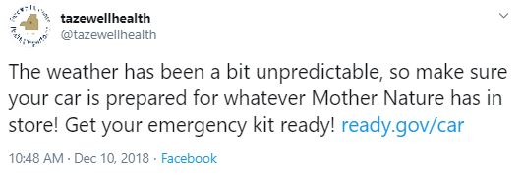
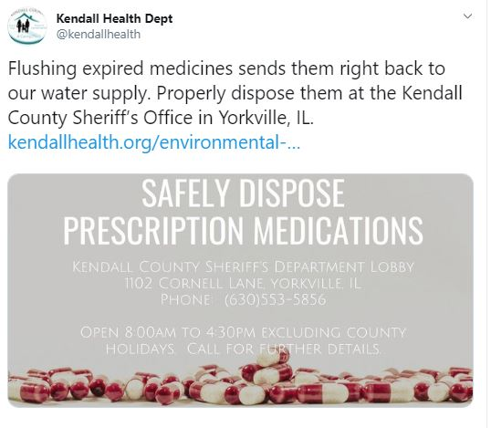
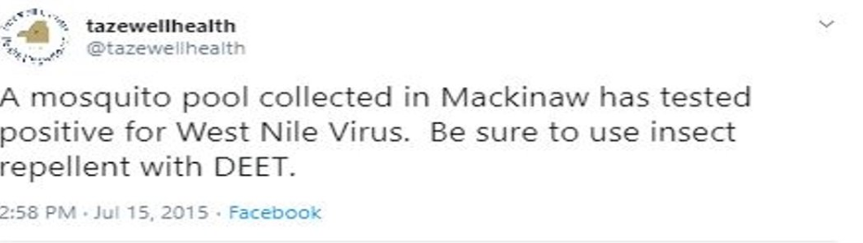
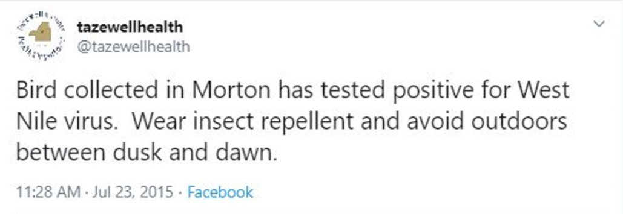
Small LHDs Retweets
Notes:
Alert and News,

Slide 29
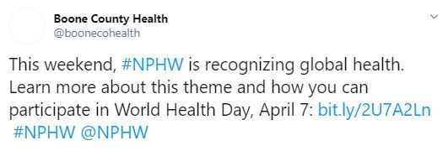
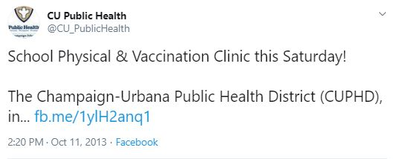
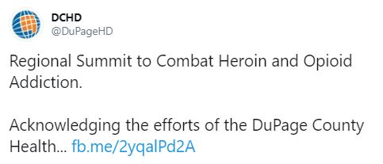
Medium LHDs Retweets
Notes:
General,General Food And Drug literacy

Slide 30
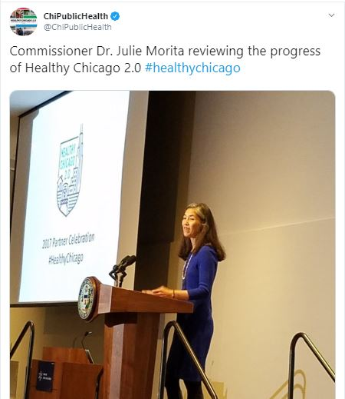
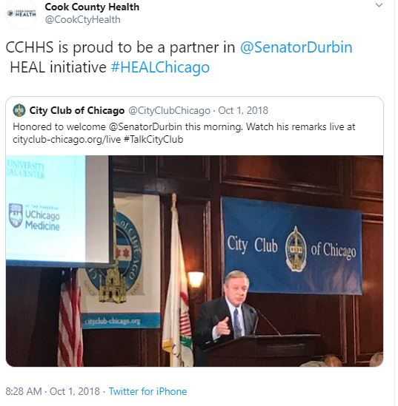
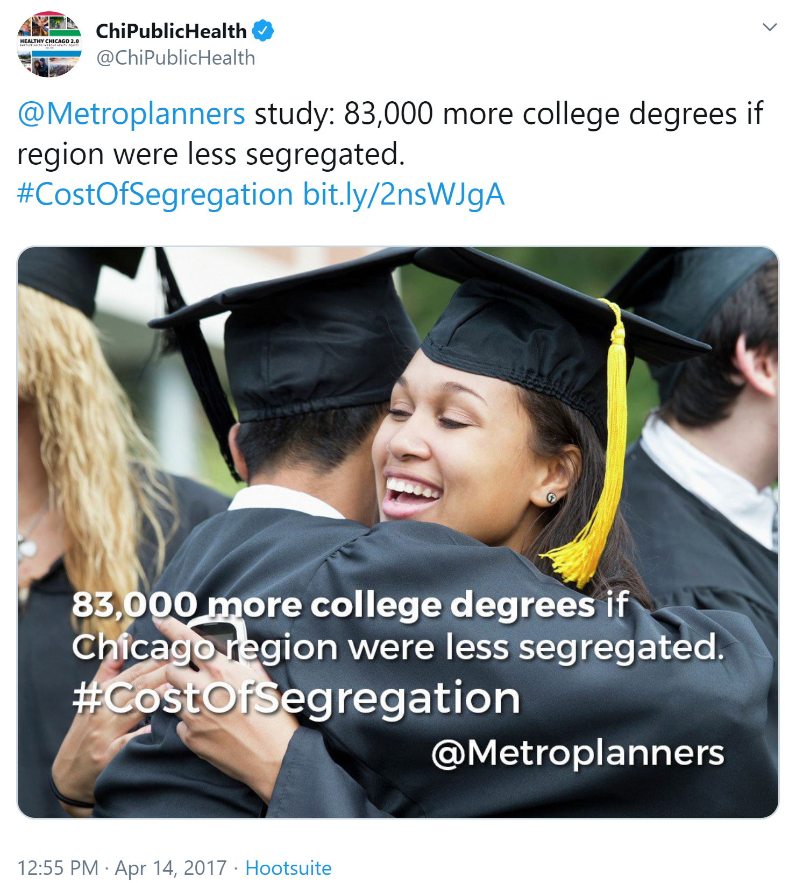
Large LHDs Retweets
Notes:
Alert and News

Slide 31
LHD Segmentation based on Population
Population has an impact on the number of Tweets; therefore segmenting the LHDs into 3 types:
Rural (Population below 6000)
Semi – Urban (Population range: 6000 - 50000)
Urban (Population above 50000)
Rural LHD includes only one LHD
Semi – Urban includes 7 LHDs
Urban includes 21 LHDs

Slide 32
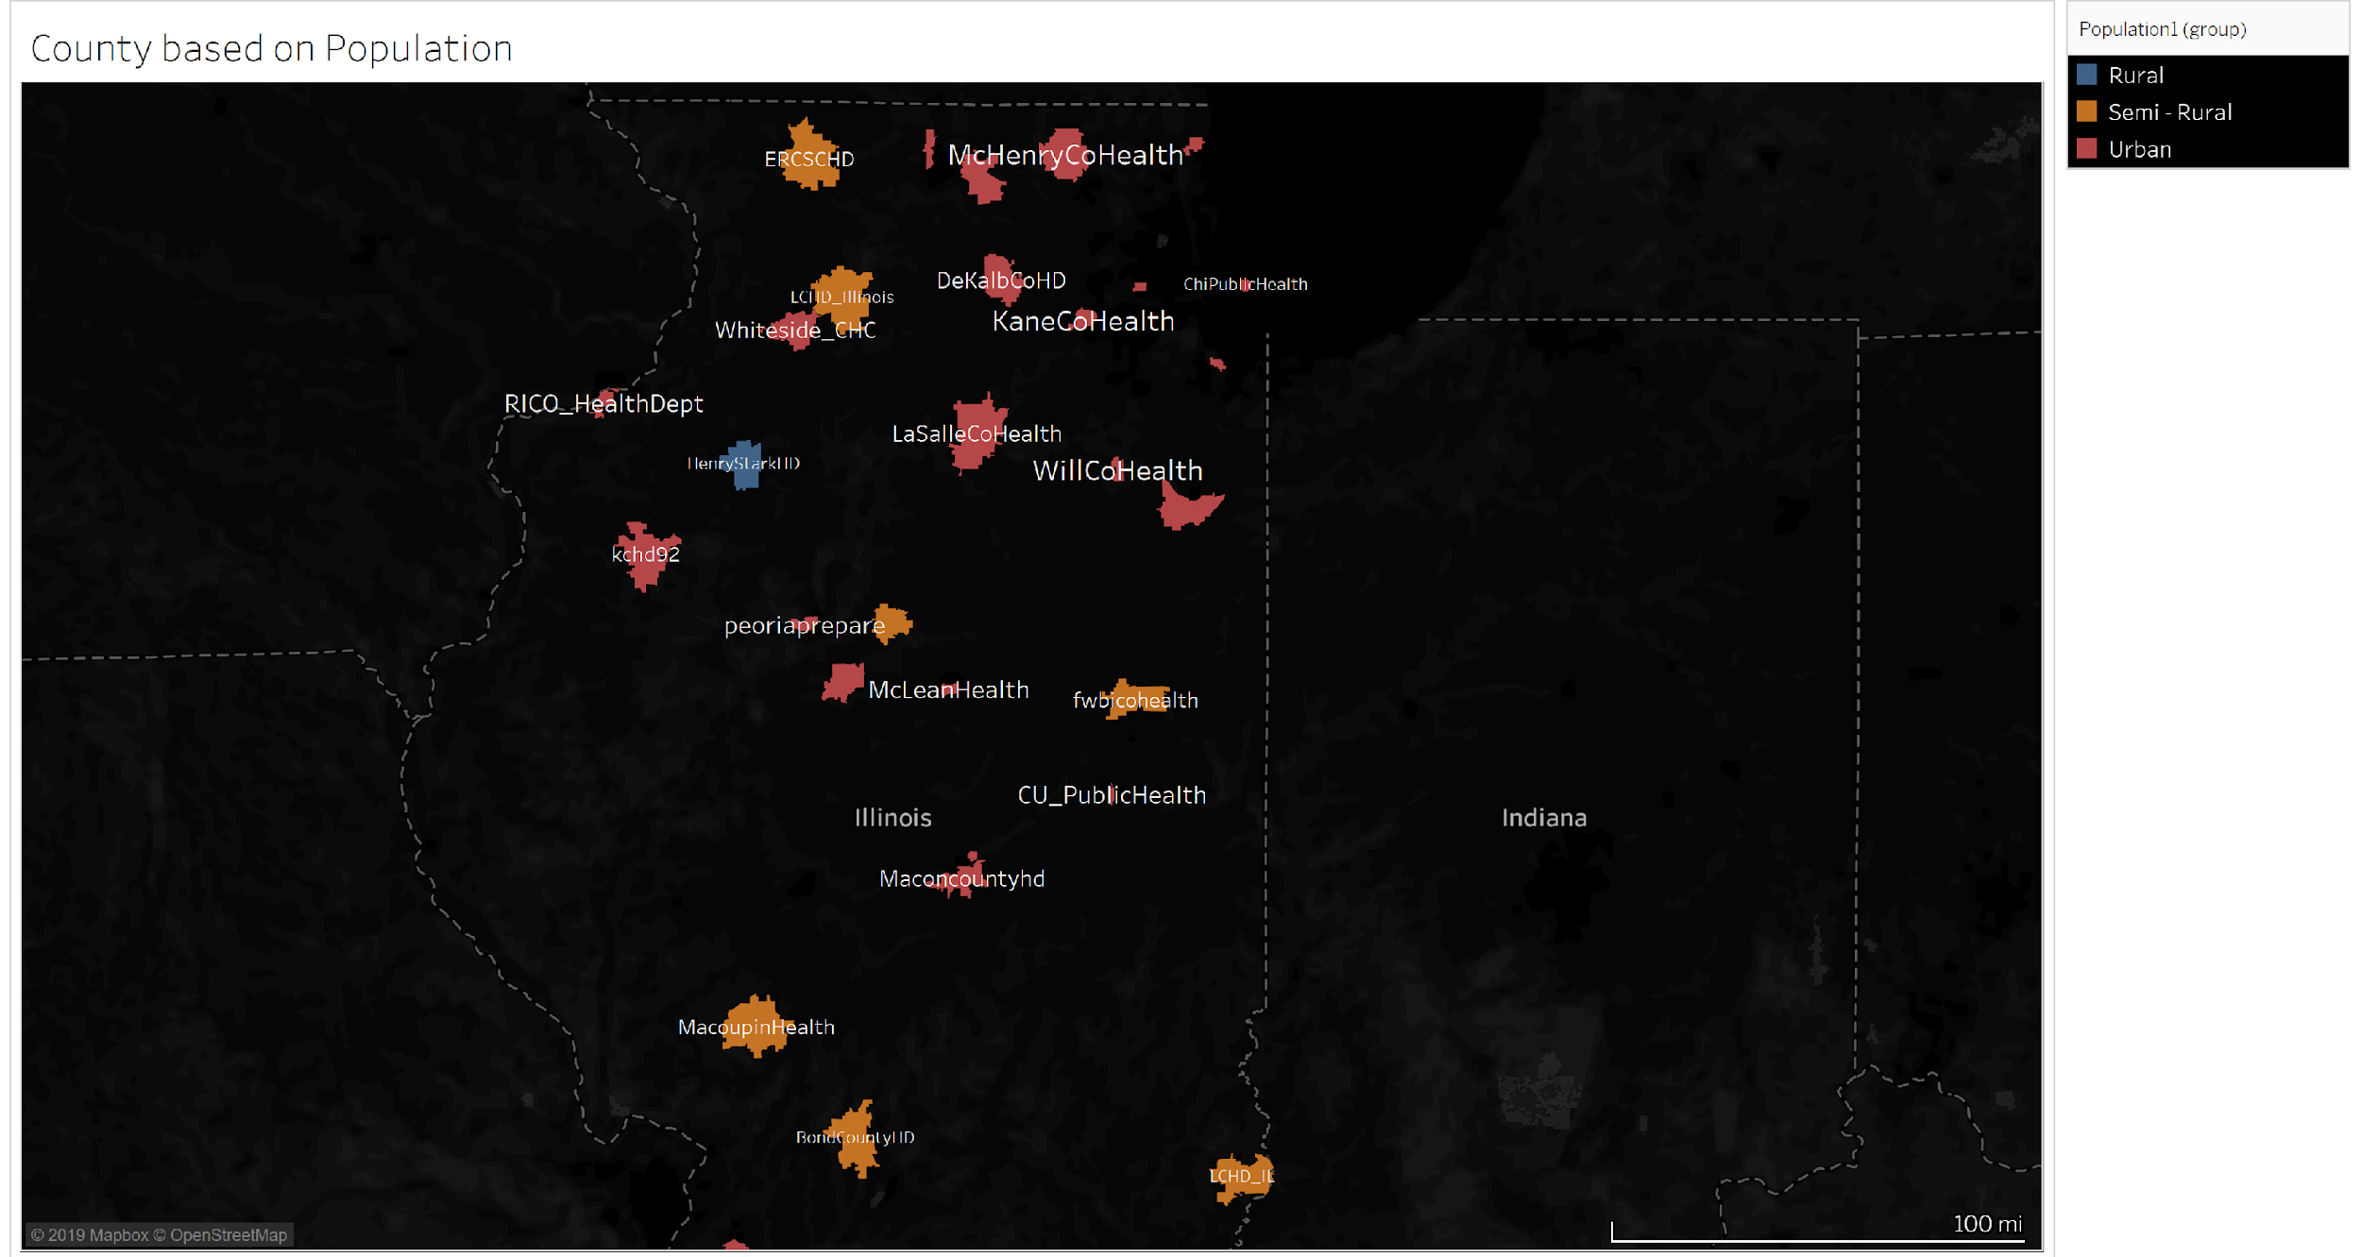

Slide 33
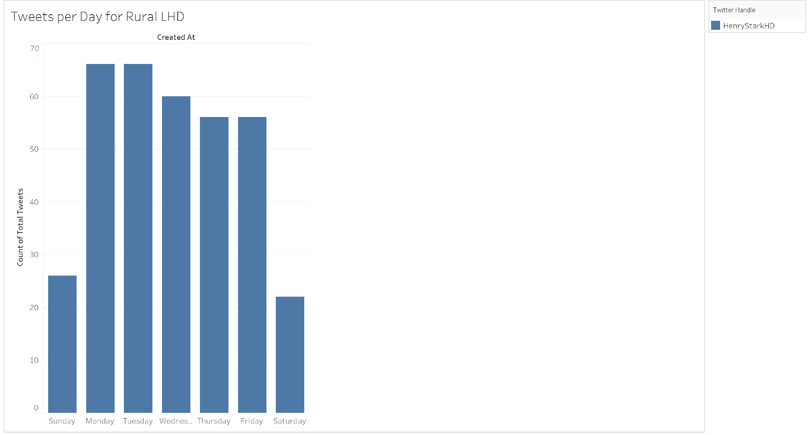
Tweets by Day of the Week for Rural LHD
Most of the Tweets were posted on Monday and Tuesday i.e. 66 by the Rural LHD
Wednesday has the second highest rank i.e. 60, in the Days for posting the tweets.
Saturday has the least count i.e. 22

Slide 34
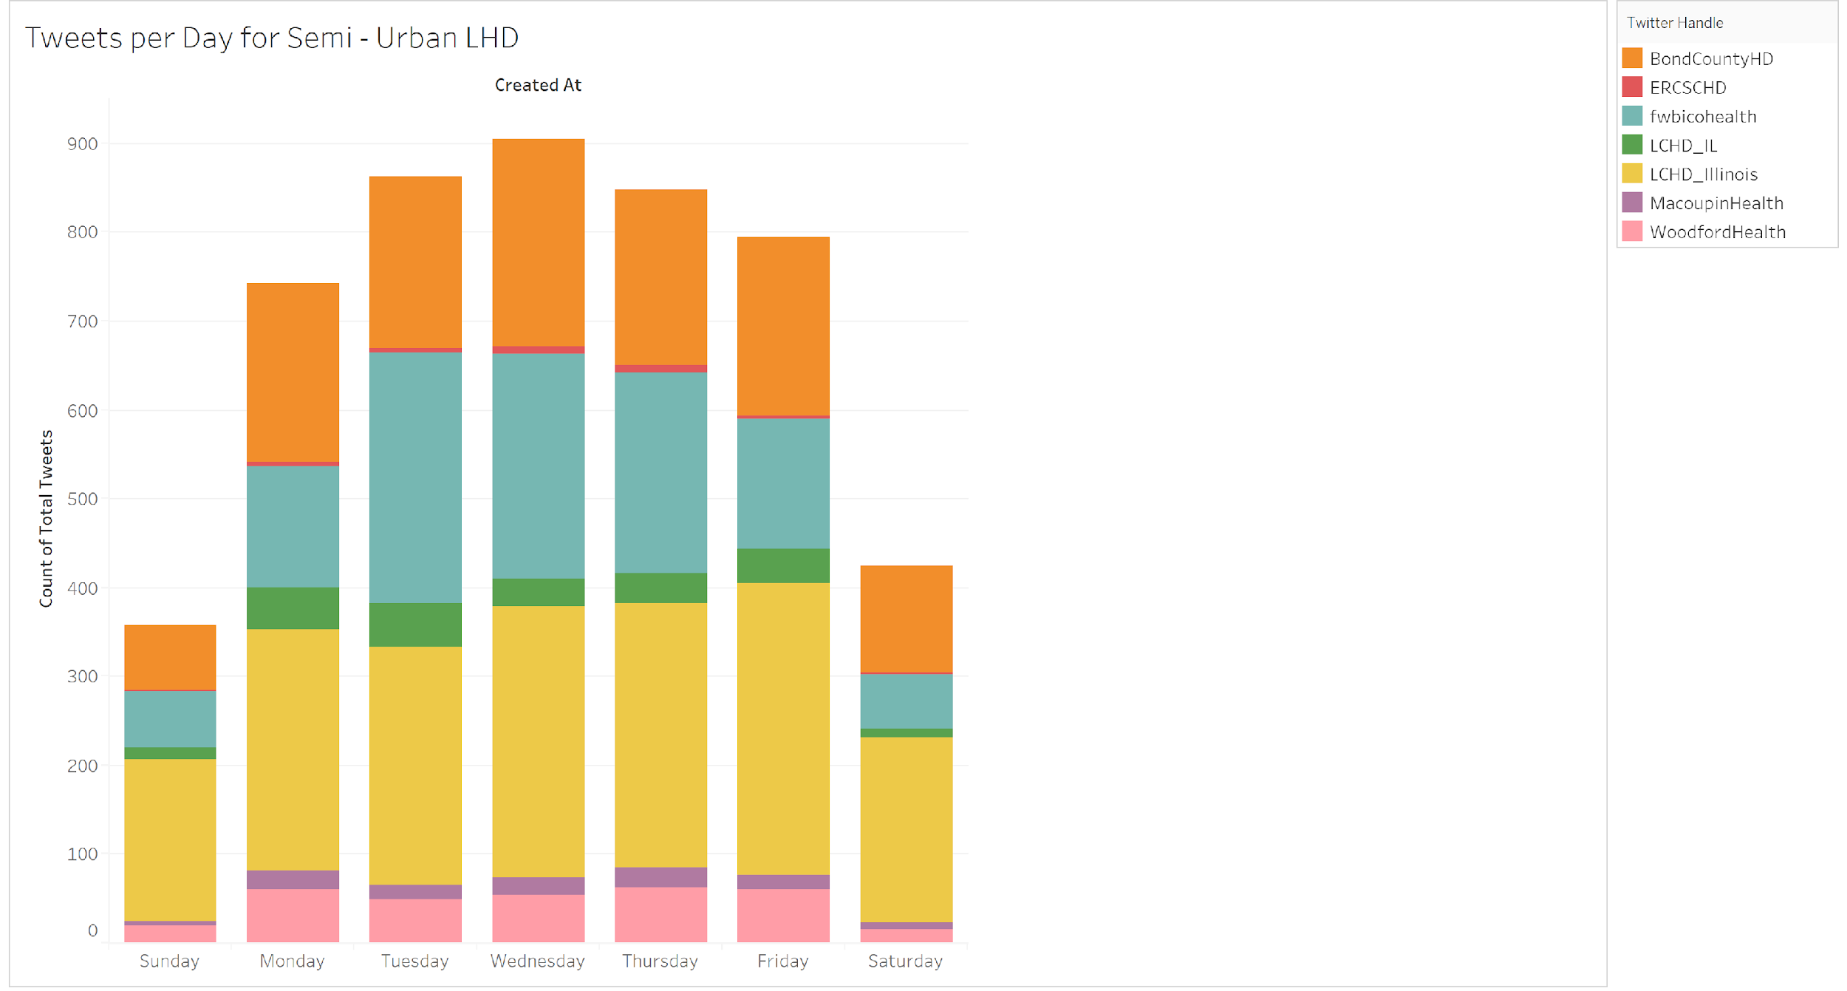
Tweets per Day for Semi – Urban LHDs
Most Semi-Urban LHDs posted tweets on Wednesday than any other day
Sunday has the least number of posted tweets as compared to other days

Slide 35
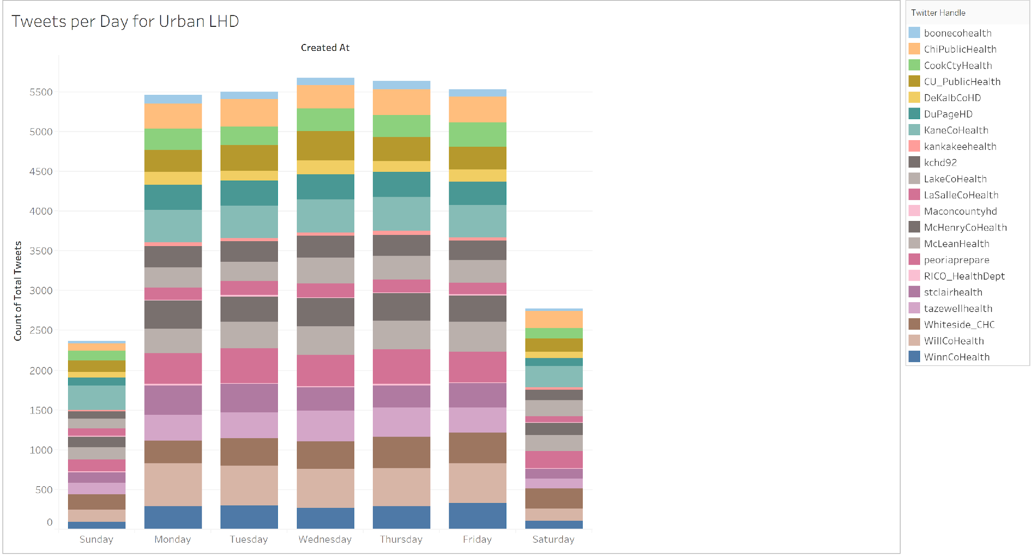
Tweets per Day for Urban LHDs
Most Urban LHDs posted tweets on Wednesday than any other day
Sunday has the least number of posted tweets as compared to other days

Slide 36
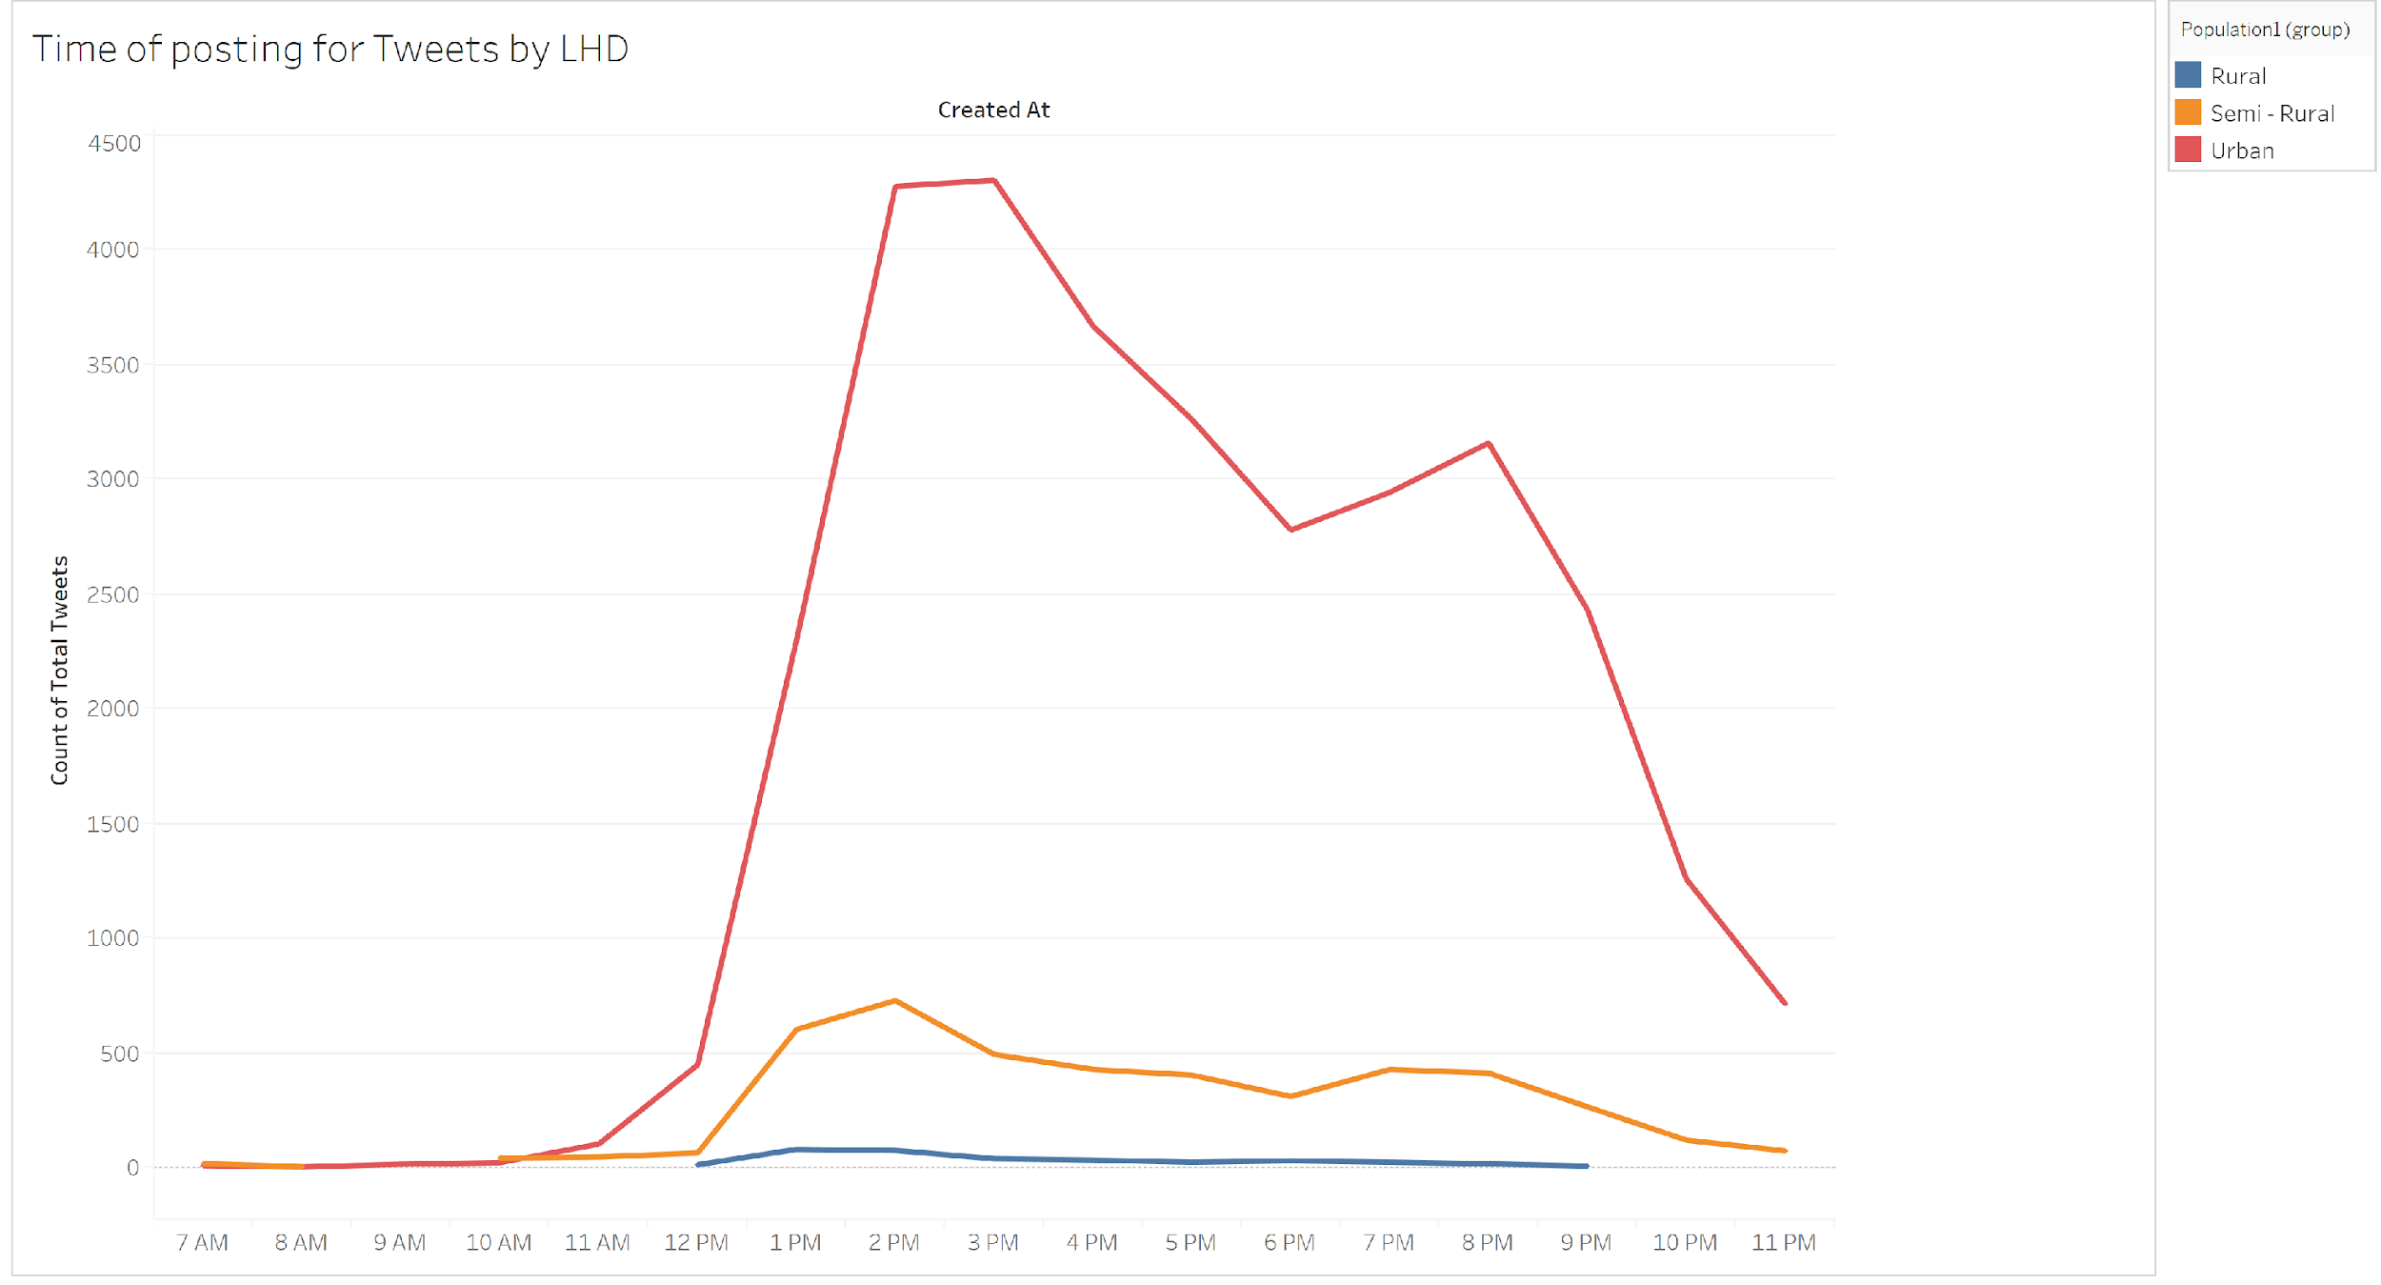
Time for posting of Tweets by LHD
Urban LHDs posted the greatest number of tweets at 3 pm
Semi-Urban LHDs posted the greatest number of tweets at 2 pm
Rural LHDs posted the greatest number of tweets at 1 pm

Slide 37
Recommendations to increase a tweet’s popularity
From the analysis we could find significant results that Urban LHDs are likely to get more retweets and favorites as compared to Semi-Urban and Rural
The presence of a popular user having millions of followers and belonging to the LHD’s county increases the number of favorites and retweets for the tweet
Also, Twitter handle characteristics are more important than tweet content related features, i.e., LHDs having more followers generated more retweets
Rural and Semi-Rural LHDs should focus on Alert and News, Child Care Literacy to generate more retweets and including videos to get more favorites
Tweets posted in January reduced the odds of generating favorites by 20%
To sum up, variables like source of the tweet, number of hashtags, Buckets like Child Care Literacy, Food and Drug literacy, Time when the tweet was posted are insignificant and they didn’t affect a tweet’s popularity

Slide 38
References
https://www.countyhealthrankings.org/app/illinois/2019/measure/outcomes/1/data
https://www.slideshare.net/jdeyaref/complete-guide-to-twitter-analytics
https://www.ncbi.nlm.nih.gov/pmc/articles/PMC4232149/#bib15
https://iquery.illinois.gov/DataQuery/REPORTMenu.aspx
https://fred.stlouisfed.org/release/tables?rid=430&eid=327361&od=2017-01-01
https://www.hrsa.gov/sites/default/files/hrsa/ruralhealth/resources/forhpeligibleareas.pdf
https://lib.ugent.be/fulltxt/RUG01/002/481/041/RUG01-002481041_2018_0001_AC.pdf
http://www.idph.state.il.us/local/alpha.htm
https://marcobonzanini.com/2015/03/17/mining-twitter-data-with-python-part-3-term-frequencies/

